Slide 1
Cluster Validity
For supervised classification we have a variety of measures to evaluate how good our model is
  Accuracy, precision, recall
For cluster analysis, the analogous question is how to evaluate the “goodness” of the resulting clusters?
But “clusters are in the eye of the beholder”!
Then why do we want to evaluate them?
  To avoid finding patterns in noise
  To compare clustering algorithms
  To compare two sets of clusters
  To compare two clusters

Slide 2
Measures of Cluster Validity
Evaluation measure that are applied to judge various aspects of cluster validity are classified into three types:
Unsupervised: Measures the goodness of a clustering structure without respect to external information. An example of this is SSE. Unsupervised methods are further divided into two classes: cluster cohesion (compactness, tightness) which determine how closely related the objects in a cluster are and cluster separation (isolation) which determines how distinct or well separated a cluster is from other clusters. Unsupervised methods are often called internal indices as they use only information present in a dataset
Supervised: Measures the extent to which a clustering structure matches some external structure. An example is entropy, which measures how well cluster labels match externally supplied class labels. Supervised methods are often called external indices, as they use information not present in the dataset
Relative: Compares different clustering or clusters. A relative cluster evaluation method is a supervised or unsupervised evaluation measure that is used for the purpose of comparison. Thus, these are not a separate type of measure, but are instead a specific use of such measures. As an example, two k-means clusterings can be compared using either SSE or entropy

Slide 3
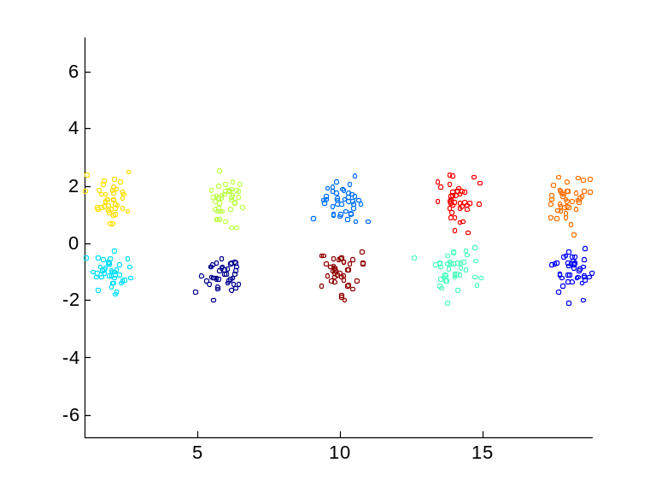
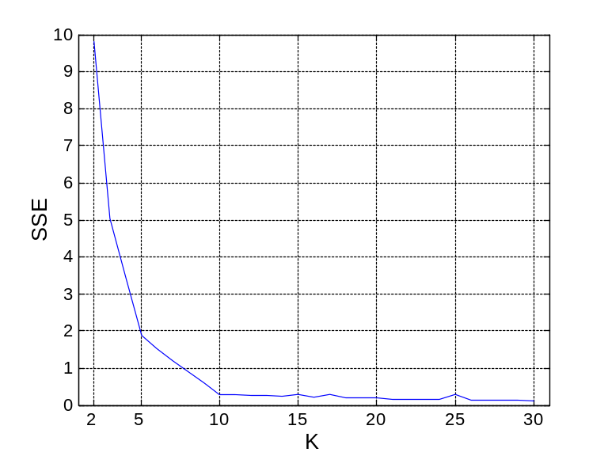
Internal Measures: SSE
Clusters in more complicated figures aren’t well separated
Internal Index: Used to measure the goodness of a clustering structure without respect to external information
  SSE
SSE is good for comparing two clusterings or two clusters (average SSE).
Can also be used to estimate the number of clusters

Slide 4
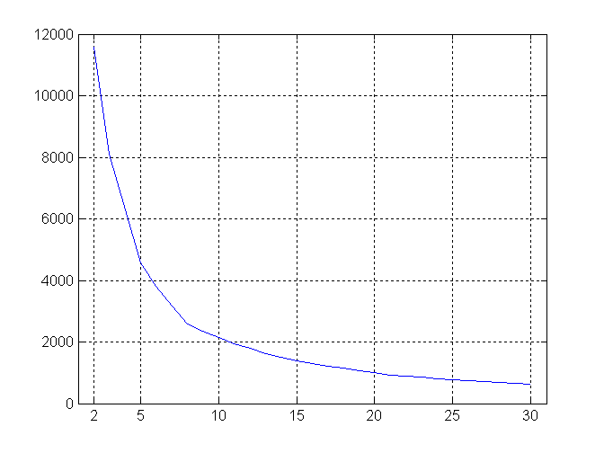
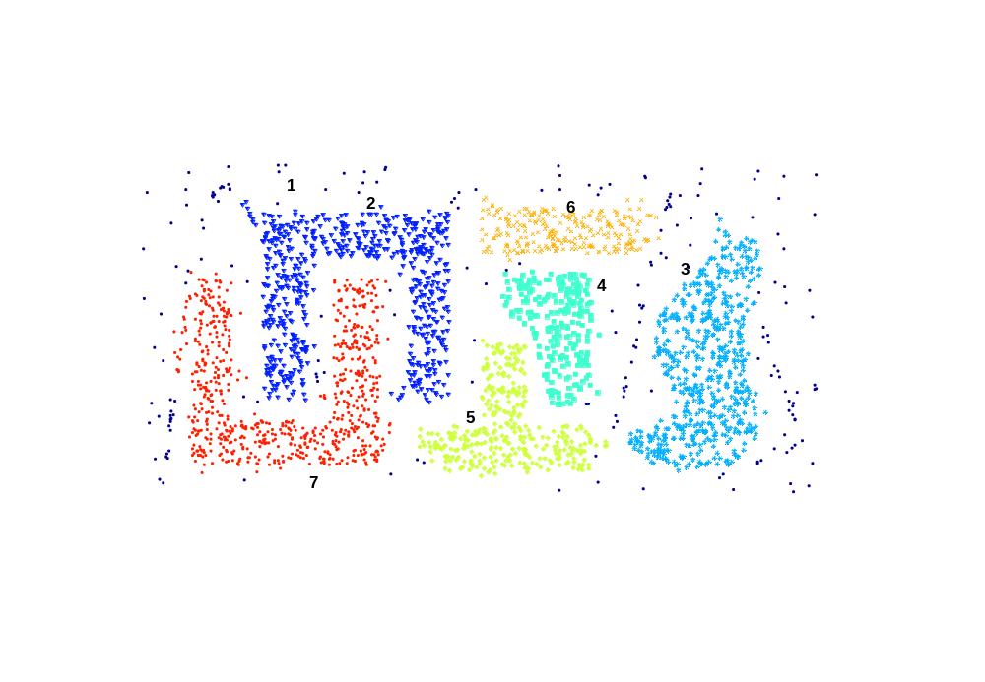
Internal Measures: SSE
SSE curve for a more complicated data set
SSE of clusters found using K-means

Slide 5
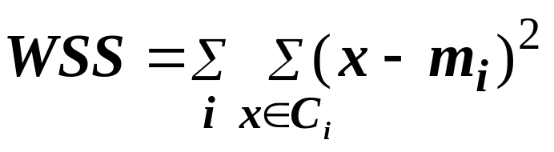
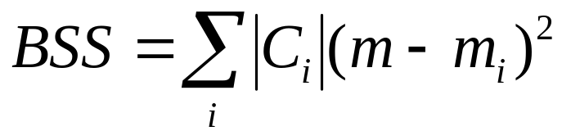
Internal Measures: Cohesion and Separation
Cluster Cohesion: Measures how closely related are objects in a cluster
  Example: SSE
Cluster Separation: Measure how distinct or well-separated a cluster is from other clusters
- Example: Squared Error
  Cohesion is measured by the within cluster sum of squares (SSE)
  Separation is measured by the between cluster sum of squares (BSS or SSB)
      Where |C_{i}| is the size of cluster i
Mean of the i^{th} cluster
Overall mean of the data

Slide 6
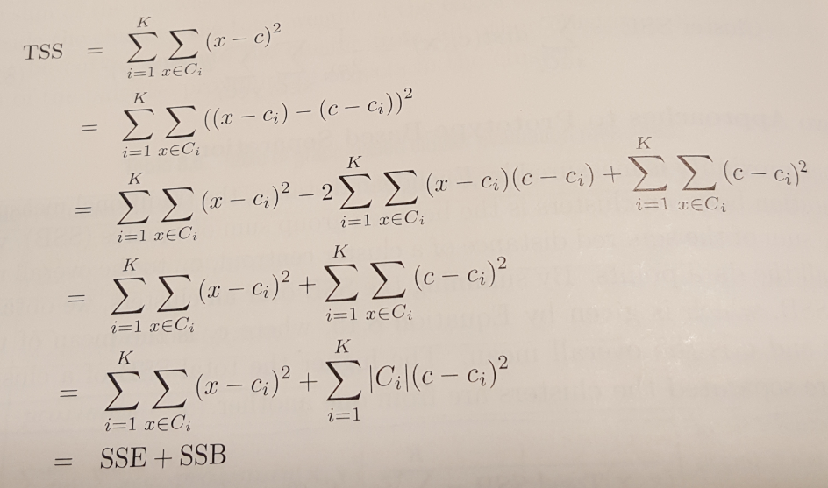
Relation between Cohesion and Separation
It can be shown that the sum of WSS and BSS is a constant and is equal to the total sum of squares (TSS)
TSS is computed as the sum of squares of the distance of each point to the overall (global) mean of the data
The importance of this results is that minimizing WSS (cohesion) is equivalent to maximizing BSS (separation)

Slide 7
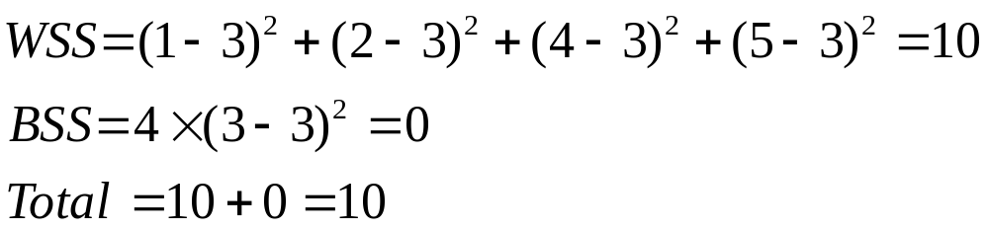
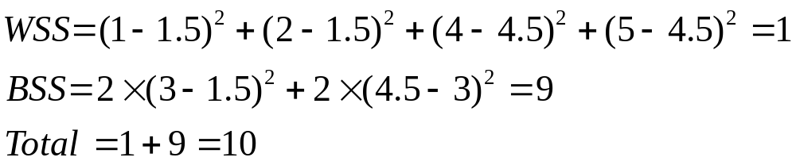
Internal Measures: Cohesion and Separation
Example: SSE
  BSS + WSS = constant
m
×
×
×
1
m₁
2
3
4
m₂
5
K=1 cluster:
K=2 clusters:

Slide 8

Internal Measures: Silhouette Coefficient
The popular measure, Silhouette Coefficient, combines both cohesion and separation
To compute the Silhouette Coefficient of a point i, follow three steps:
  Calculate its average distance to all other objects in its cluster. Call this value a_{i}
  Calculate its average distance to all objects in a cluster not containing the object. Find the minimum of these values with respect to all clusters. Call this value b_{i}
  For the ith point, the Silhouette Coefficient is computed as:
The value of Silhouette Coefficient can vary between -1 and 1
A negative value is undesirable as that means a_{i}, the average distance to points in the cluster is greater than b_{i}, the minimum average distance to points in another cluster
We want the Silhouette Coefficient to be positive (a_{i} < b_{i}) and a_{i} to be as close to 0 as possible, since the coefficient assumes its maximum value of 1 when a_{i} = 0

Slide 9
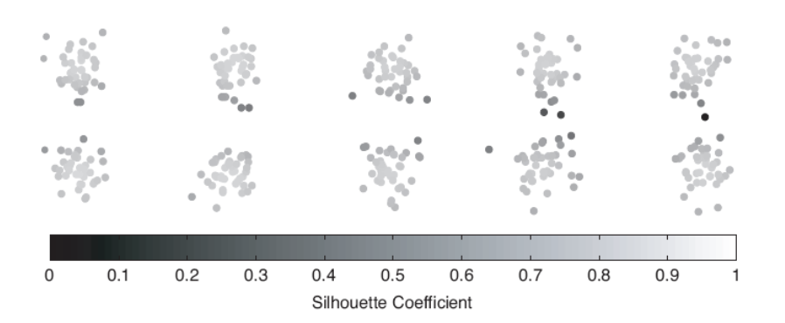
Internal Measures: Silhouette Coefficient
We can compute the average Silhouette Coefficient of a cluster by simply averaging the Silhouette Coefficient of the points belonging to that cluster
An overall measure of the goodness of a clustering can be obtained by computing the average Silhouette Coefficient of all points
A plot of the Silhouette Coefficients for points in 10 clusters. Darker shades indicate lower values

Slide 10
External (Supervised) Measures of Cluster Validity
When we have external information about data, it is typically in the form of externally derived class labels for the data objects
In such cases, the usual procedure is to measure the degree of correspondence between the cluster labels and the class labels
It basically compares the clustering results against the ground truth
Two commonly used measures are entropy and purity

Slide 11
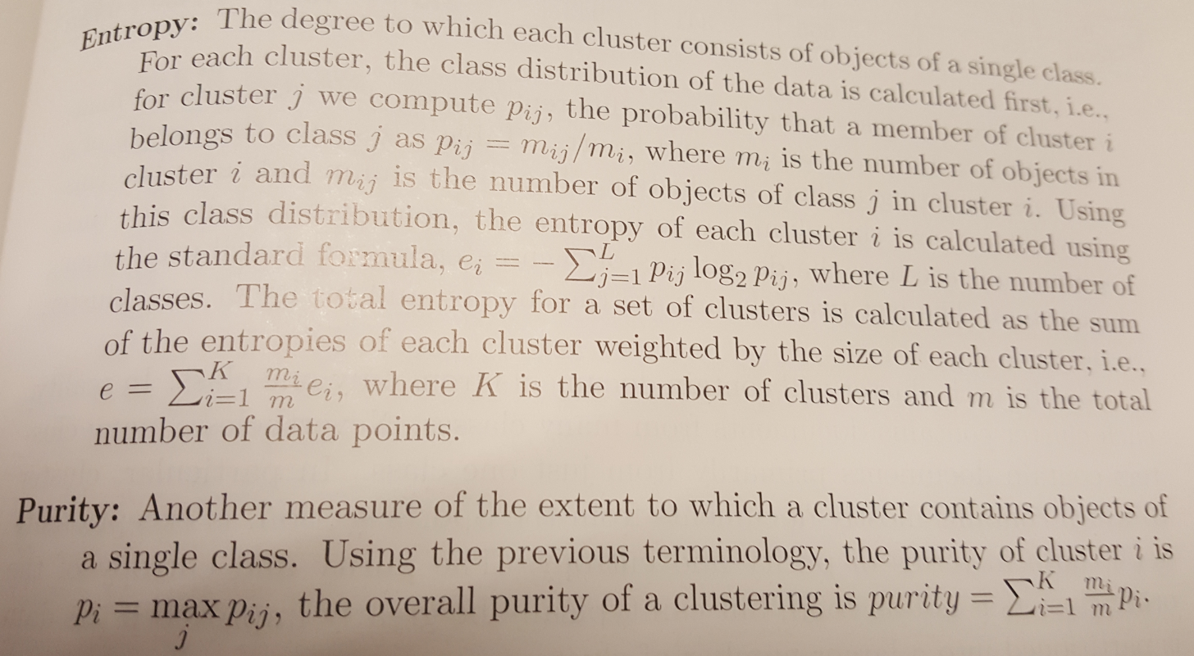
External (Supervised) Measures of Cluster Validity
Lower values of entropy denote better clustering results
Higher values of purity denote better clustering results

Slide 12
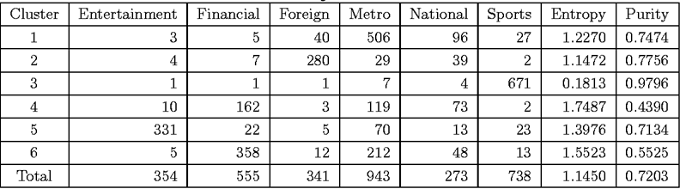
External Measures of Cluster Validity: Entropy and Purity
Example: k-means clustering was used to cluster 3204 newspaper articles from LA Times. These articles come from 6 classes.
Ideally, each cluster will contain documents from only one class. In reality, each cluster contains documents from many classes. However, many clusters contain documents primarily from one class.
For instance, cluster 3 mostly contains documents from the Sports category and is very good, both in terms of entropy and purity

